Slide 1
Virtual Labs
Name: Trung Ngo
Memebers: Crystal Rivera, Scrum Master
Daniel Gonzalez , Developer
Johann Henao, Developer
Juan Riano, Developer

Slide 2
Problem Definition
The current system utilizes Moodle as a means to keep track of resources allocated to them as well as view future resources. This data is then used through eFront to use their resources.
Current Limitations
The user must login through Moodle to view and request their resources.
The user must login to eFront to use the requested resources.

Slide 3
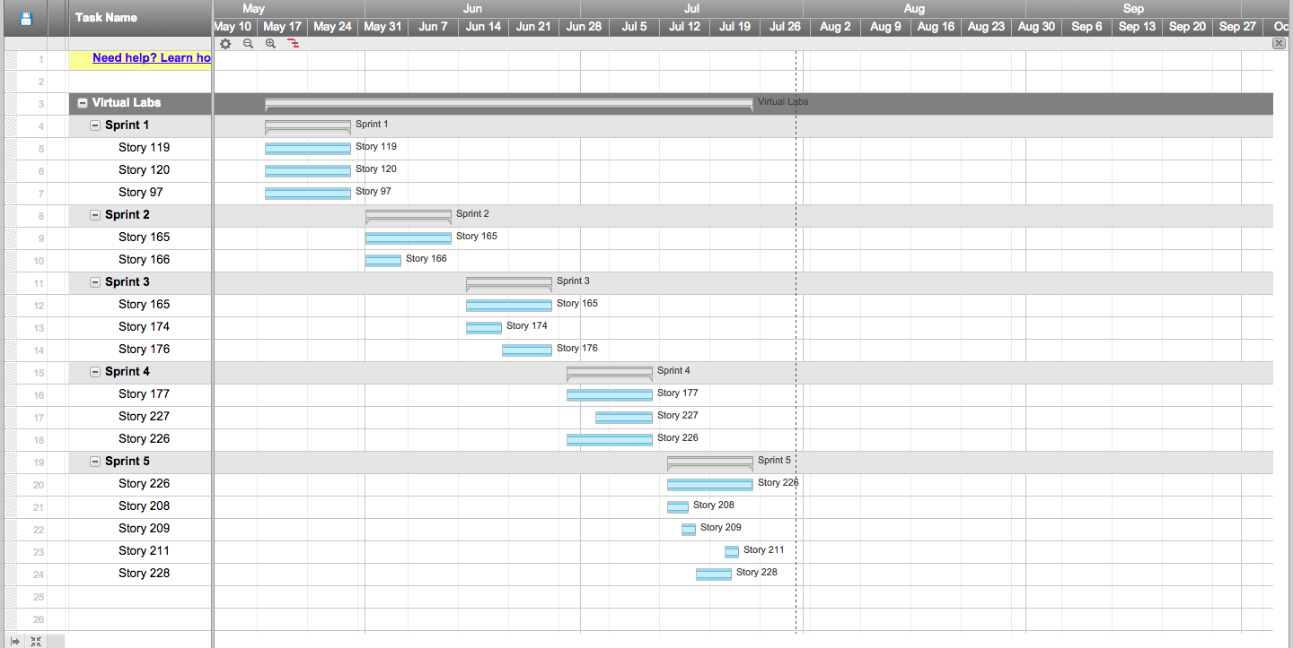
Project Management

Slide 4
Requirements

Slide 5
User Stories Implement
Major:
Story 165: Migrate Quota System from Moodle to eFront
Minor:
Story 166: Migrate add quota policy from Moodle to eFront
Story 176: Migrate credit types form in the Quota System from Moodle to eFront
Story 227: Enable the view to be separated by roles for the Scheduler module
Story 228: Convert existing Moodle Database calls to eFront equivalents

Slide 6
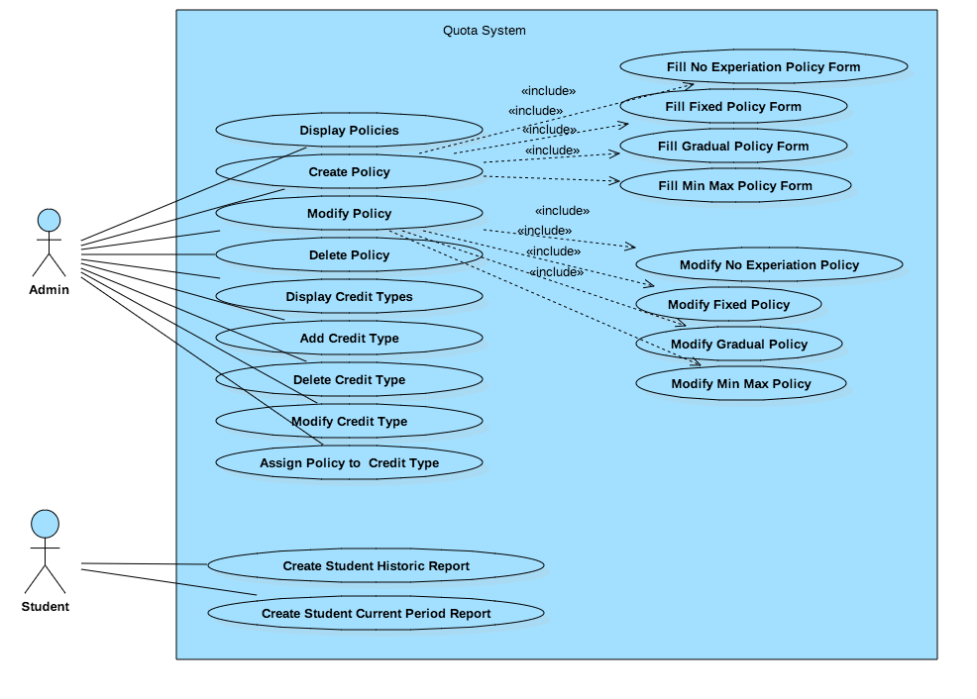
UML Use Cases Quota System

Slide 7
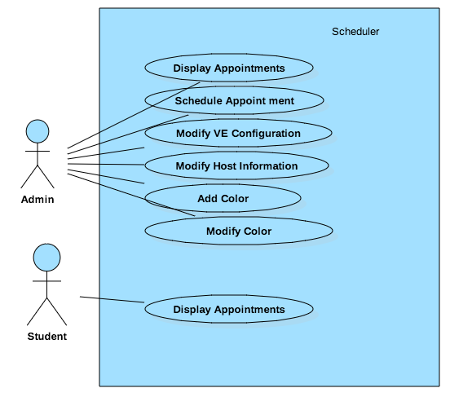
UML Use Cases Scheduler

Slide 8
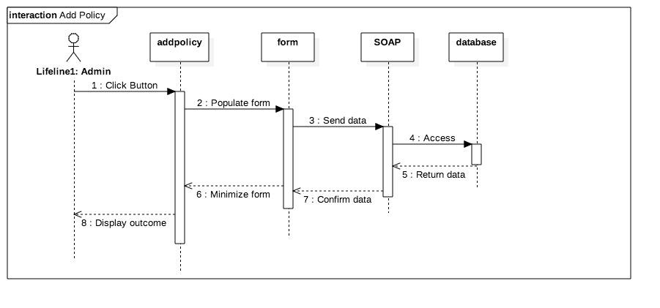
UML Sequence Diagram

Slide 9
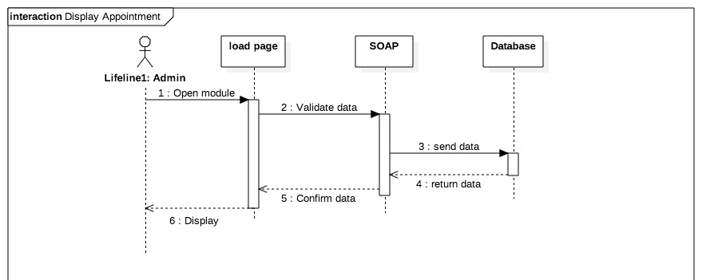
UML Sequence Diagram

Slide 10
System Design

Slide 11
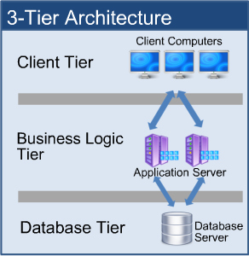
System Decomposition
Both the Quota System and Scheduler share the same design architecture.

Slide 12
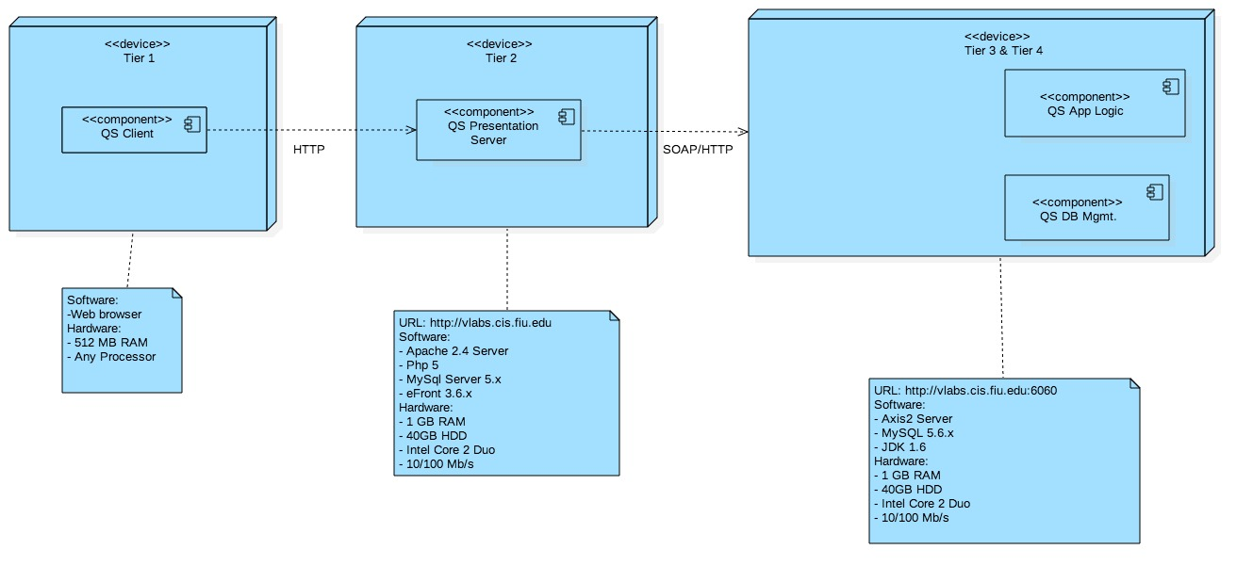
System Deployment

Slide 13
Persistent Data Design
Quota system maintains several tables:
Courses
Course enrollment
Course quota
Policy
Credit type
Used quota
Used assigned quota
User profile
Scheduler maintains several tables:
Colormap
User info
User fields

Slide 14
Security/Privacy
Quota system manages policy and credit types for Virtual Labs.
Views: Separate views depending on roles
SOAP calls: external data retrieval
Scheduler manages host, colors, VE configurations, and time allotments.
Views: Separate views depending on roles
SOAP calls: external data retrieval

Slide 15
Detail design

Slide 16
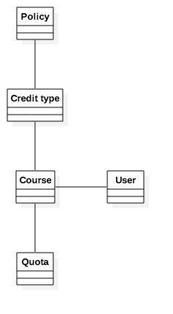
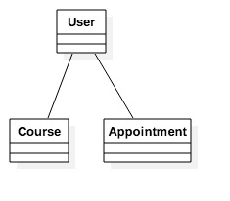
Minimal Class Diagram
The class diagram for the Quota System is on the left and the Scheduler is above

Slide 17
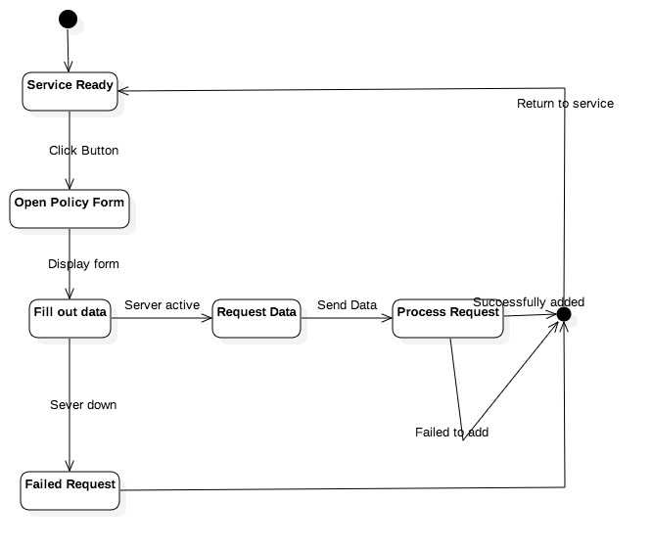
State Machine Quota system

Slide 18
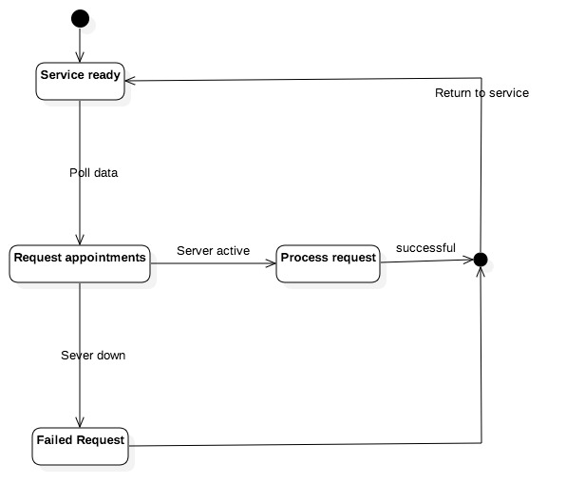
State Machine Scheduler

Slide 19
Main Algorithm-Quota System
Policy
To add a policy, click the add policy button, fill in the relative data for the policy, validate data to send to server, send data to the server, validate returned data.
Credit type
To add a policy, click the add credit type button, fill in the relative data for the policy, validate data to send to server, send data to the server, validate returned data.

Slide 20
Main Algorithm-Scheduler
Scheduler
Determine the user and present them with a corresponding view. The admin will be given a view of all resource allotment or future allotment for all students. Students will be given a view of all resource allotment they have been given or will be given

Slide 21
Verification

Slide 22
Test Cases – Sunny Day Quota System
Test Case | Add No Expiration Policy
Purpose | Add a no expiration policy to the database and inform the user that the policy has been added.
Set up | User is logged in to the website, has the module open, and clicked the Add Policy button
Input | Name: TestTN-100 Quota In Period: 120 Active: True Assignable: True Type: No Expiration, Relative No. of Days: 5 Description: Test quota for 120 minutes.
Expected Output | Policy is added to the database.
Actual Output | As expected.

Slide 23
Test Cases – Rainy Day Quota System
Test Case | Add No Expiration Policy
Purpose | Add a no expiration policy to the database and inform the user that the entry already exists.
Set up | User is logged in to the website, has the module open, and clicked the Add Policy button. A database entry with the name TestTN-100 exists.
Input | Name: TestTN-100 Quota In Period: 120 Active: True Assignable: True Type: No Expiration, Relative No. of Days: 5 Description: Test quota for 120 minutes.
Expected Output | User is informed that the entry already exists
Actual Output | As expected.

Slide 24
Test Cases – Sunny Day Scheduler
Test Case | Display appointment
Purpose | Display all appointments for the admin.
Set up | User is logged in to the website, has the module open, and the cookie for displaying the data exists.
Input | N/A
Expected Output | Amin will see all the appointments that have been made.
Actual Output | As expected.

Slide 25
Test Cases – Rainy Day Scheduler
Test Case | Display appointment
Purpose | Display all appointments for the admin, for the virtual environments.
Set up | User is logged in to the website, has the module open.
Input | N/A
Expected Output | Amin will see all the appointments that have been made for the virtual environments.
Actual Output | As expected.

